Slide 1
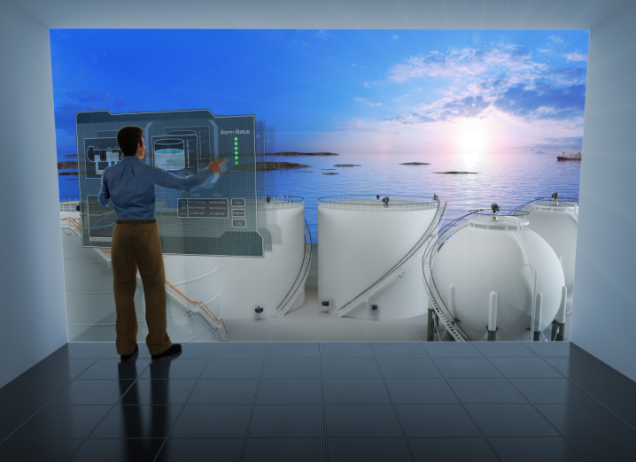
Welcome to a New Era in Tank Gauging
1

Slide 2


Slide 3
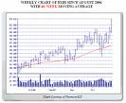
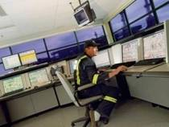
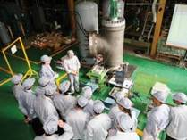
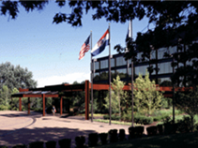
Emerson At-a-Glance
Founded in 1890
NYSE: EMR
Diversified global manufacturer and technology provider
Approximately 127,700 employees worldwide
Headquarters in St. Louis, Mo.
Manufacturing and/or sales presence in more than 150 countries
240 manufacturing locations worldwide and 127,700 employees
No. 117 on 2010 FORTUNE 500 list of America’s largest corporations
Notes:
3

Slide 4
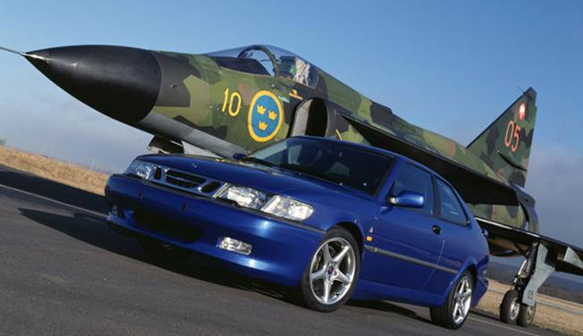
Rosemount Tank Radar History
1974 Sprung out of the Saab Missile Division as
Saab Marine Electronics
1976 First Tanker Delivery
1980 World Leader in Marine TG
1984 First On Shore delivery
1996 World Leader in Oil Industry TG
2001 - Acquired by Rosemount
2002- 2007 3 new 2-Wire Level Gauges for Process Industry and a new Marine system STar
2010 New RAPTOR Tank Gauging System
Notes:
Frank Werner, Vern Heath, and Robert Keppel established Rosemount Engineering Company with $8000 of startup funds.
Government needed air speed sensor for aircraft. And asked U of M to develop. They liked the product and wanted to order more which wasn’t possible. These three went off to start their own company in a chicken coupe.
1960… Rosemount sensors on every aircraft in the world.

Slide 5
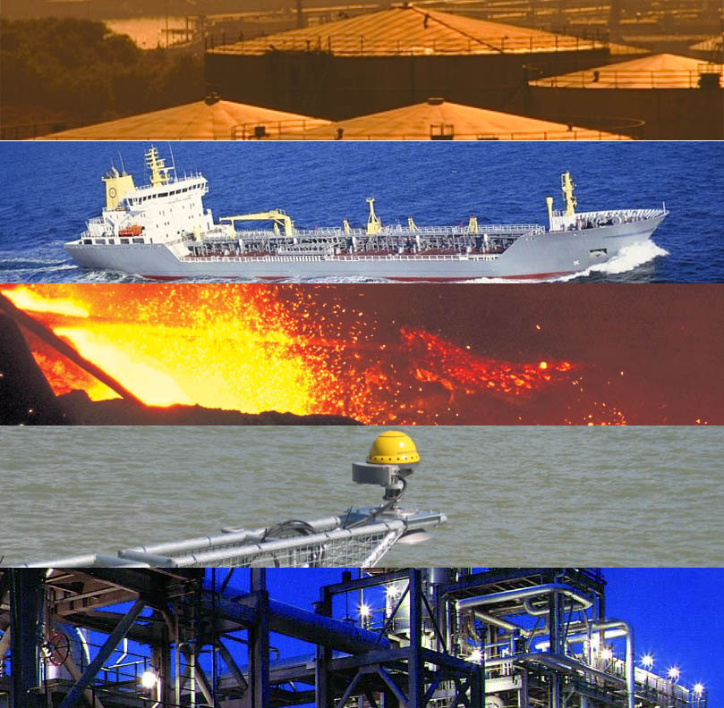
SERVE DIFFERENT MARKETS
Reliable and highly accurate tank gauging systems for refineries and tank terminals
Level gauging and cargo/ballast control
Steel industry
Measuring of wave height
Chemical/Process industry

Slide 6
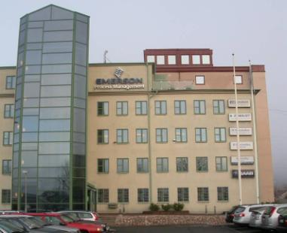
Rosemount Tank Radar
Headquartered in Gothenburg, Sweden
400 With 297 based in Sweden
( Linköping and Jönköping R&D)
Three production Lines
(7 production groups)
TG Offices in Bahrain, Houston US & India
Recognized as one of the most innovative companies in Sweden
Center of Excellence for Radar Level Systems

Slide 7
Basic Data
Production Lines
60people in 7 production groups
Workshop including storage
3 floors in one building and 3 other buildings
5500 sq. meters (59000 sq. feet)
Inventory
Raw materials 70 MSEK
Customer WIP (Work in progress) 20 MSEK
Purchased materials
300 MSEK (50 MSEK Buy-outs) annually

Slide 8
Production/Factory Organisation
Production department is product oriented
Each product family is taken care of by a product group
Each product group has appointed purchasers
Each product group:
Plans
Builds
Tests
Packs

Slide 9
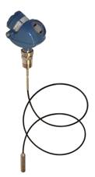



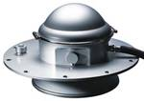

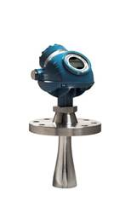
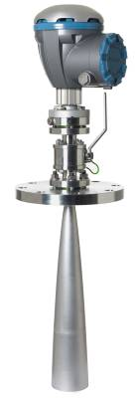



Major Product Development History
World leader in level gauging for tankers
World leader in the oil industry
LNG/LPG gauge for tanker & TankRadar Rex
1976
1984
1997
2002
Rosemount 5400
2007
Rosemount 5900
First tanker delivery – SUM21
1980
First onshore delivery - TRL
1996
TankRadar PRO
1999
TankRadar STaR & Rosemount 5600 and 3300
2004
Rosemount 5300
2010
2007 Rosemount 5300
1976 SUM21
2002 TankRadar STaR
2002 Rosemount 3300
1999 TankRadar Rex
1984 TRL
1997 TankRadar PRO
1999 LNG/LPG
2002 Rosemount 5600
2004 Rosemount 5400
2010 Rosemount 5900

Slide 10
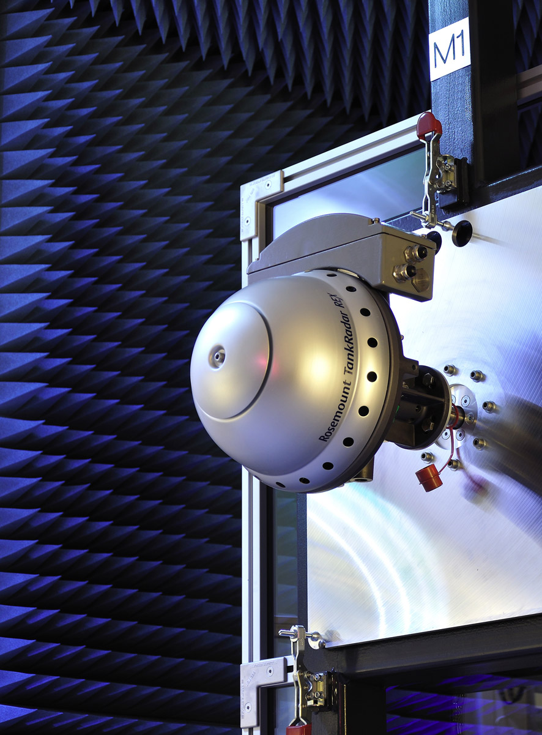
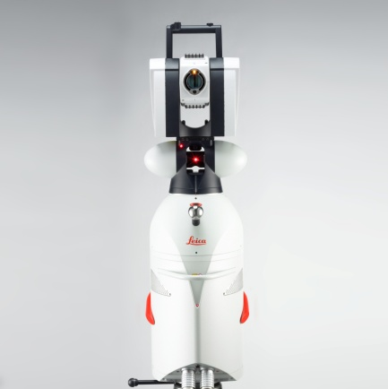
TankRadar® - Accuracy Verification
Fully automated data collection and calibration functionality
Two High Accuracy Distance References using Leica Tracking Lasers as reference
Accuracy Target ±0.16 mm (± 6.3 mil) covering a range from 0 to 30 meters (0 to 98.4 feet)
Low level of radar disturbances and reflections from surrounding walls, floor and ceiling
Leica Tracking Laser

Slide 11











Level Leadership Team
Rosemount Level
Jon Stokes
VP/GM
Mobrey
E&D
Operations RTR
Joe Willson
Managing Director
Mats Nordlund
Director
Rasmus Johansson
Director
Tank Gauging
Finance & IT
Quality
Rikard Lövdahl
General Manager
Lars Edman
Director
Gerth Forlin Director
Process Radar
Human Resources
Supply Chain
Peter Lagerlöf
General Manager
Malin Linden
Director
Richard Ahlebrand
Director
Process Level
Marketing Steering
Group
Operations Mobrey
Chris Rooke
Director

Slide 12
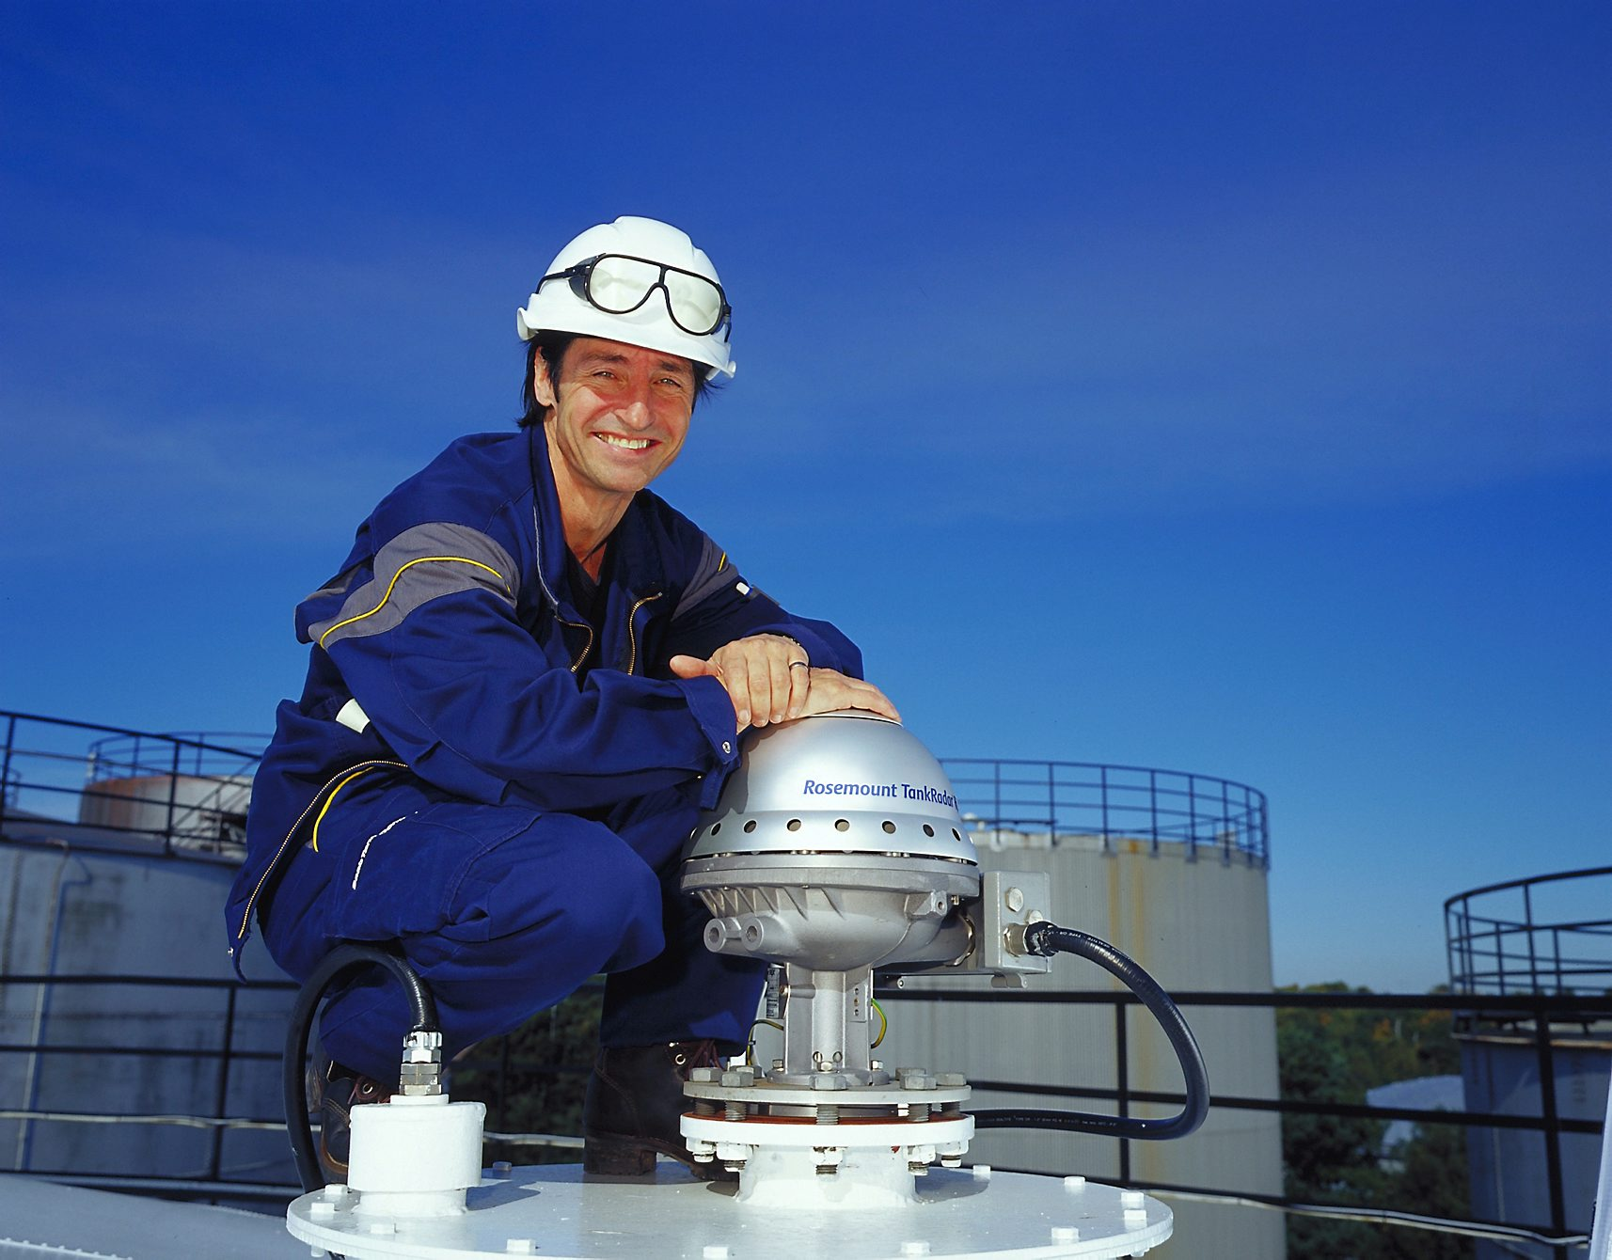
Rosemount Tank Gauging
Bild på en Rex installation
World Leader in Radar Tank Gauging

Slide 13
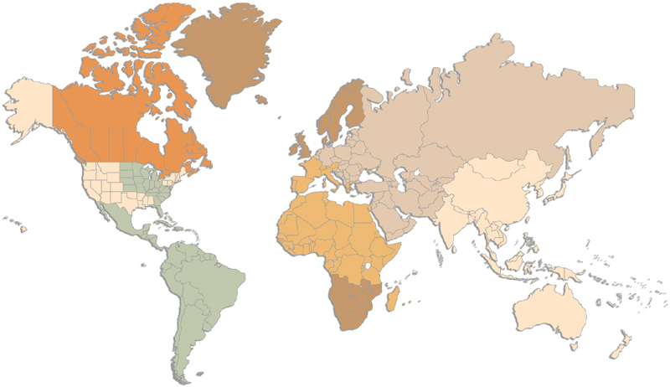
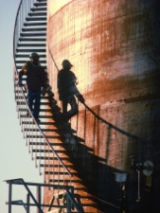
Tank Gauging – Sales Channel
HQ
Subsidiary
Emerson
Locally positioned Area Manager
Distributor

Slide 14
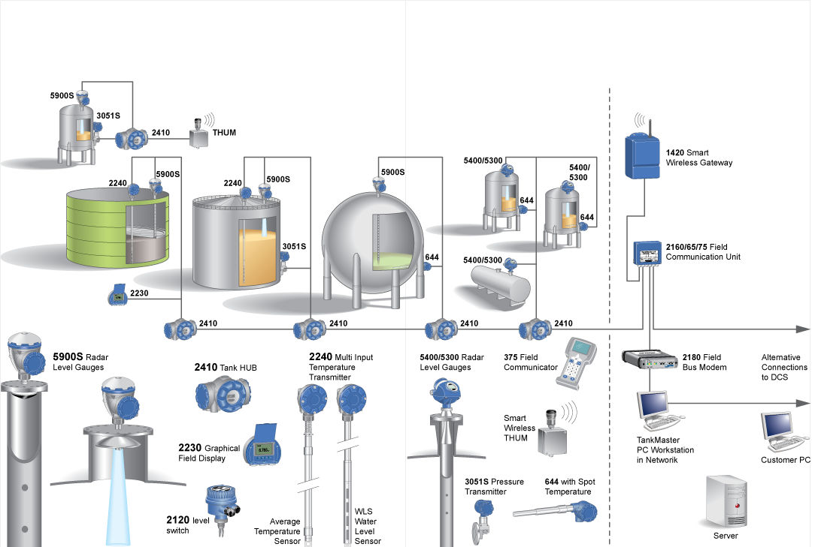
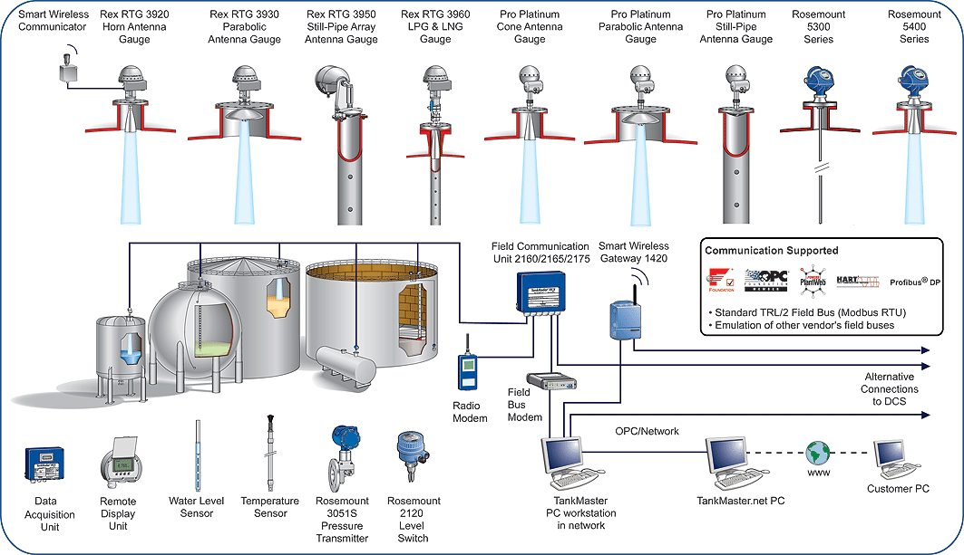
Rex System Layout
Raptor System Layout

Slide 15

Welcome to a New Era in Tank Gauging

